Slide 1
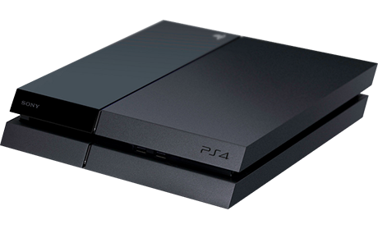
Playstation 4 vs Wii U

Slide 2
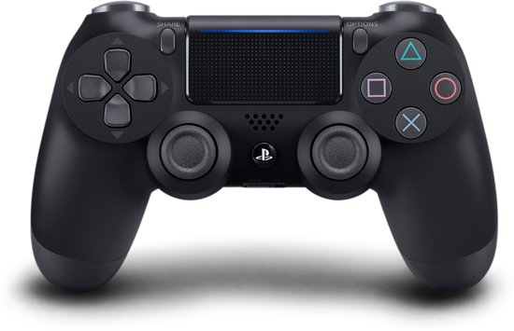
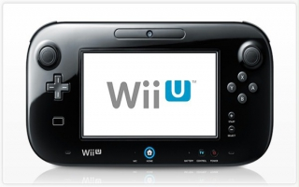
Playstation 4 vs Wii U

Slide 3
Playstation 4 vs Wii U

Slide 4
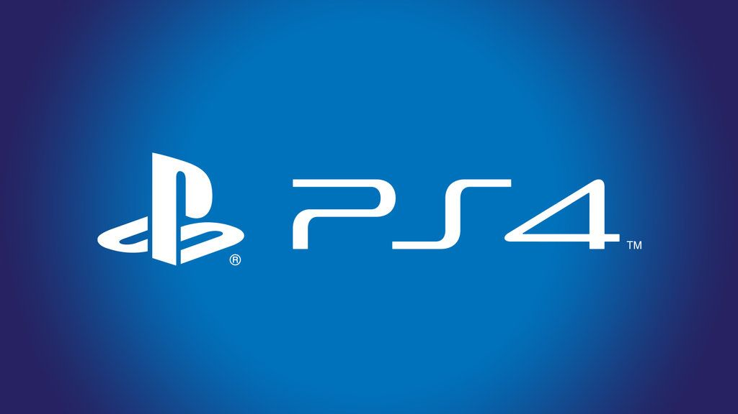
Playstation 4 vs Wii U

Slide 5
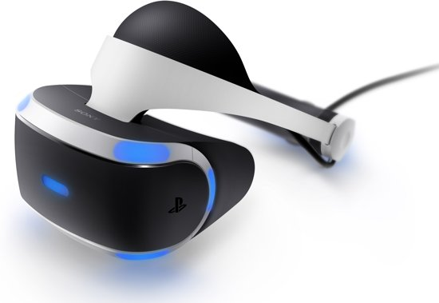
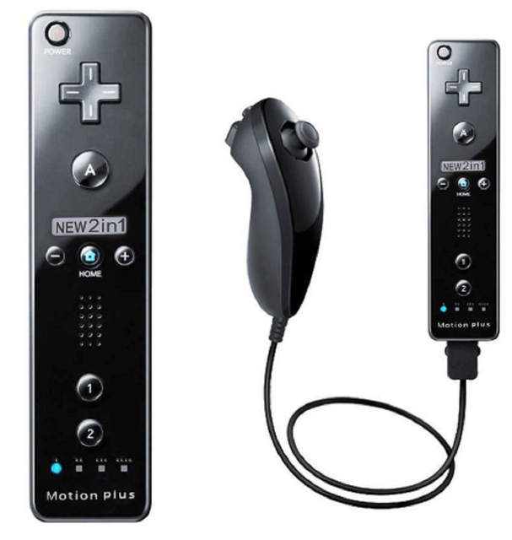
Playstation 4 vs Wii U

Slide 6
Playstation 4 vs Wii U

